Slide 1
EIT x Soft Robots: project update
Week of Monday 29/03/2021

Slide 2
Work accomplished this past week:
Refined EIDORS simulation
Fabricating a simple actuator

Slide 3
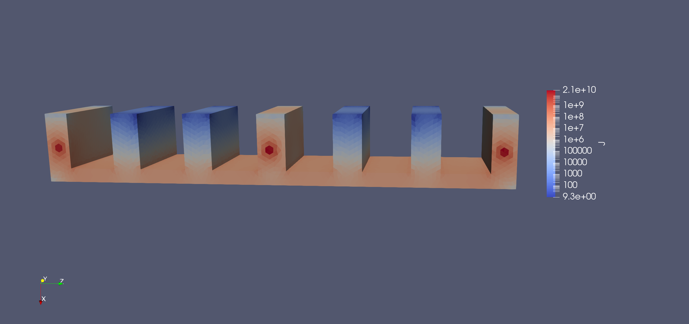
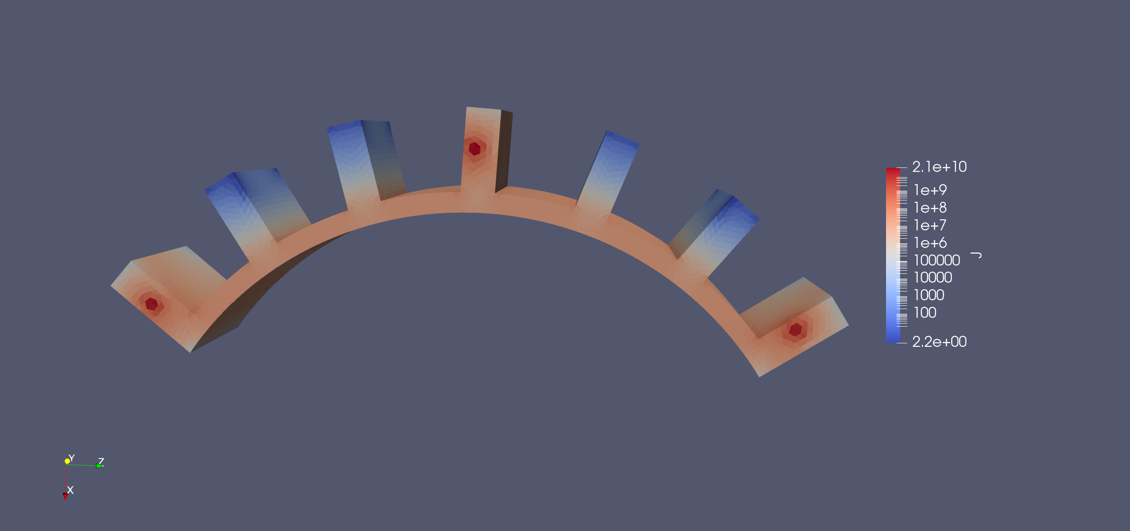
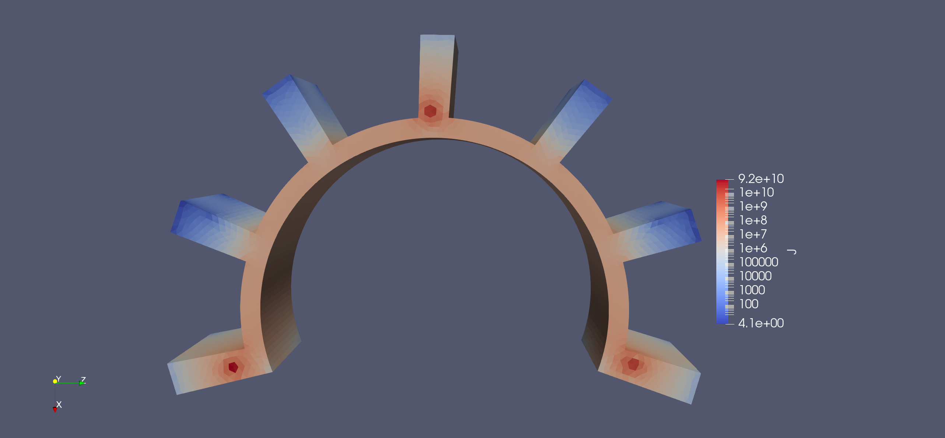
EIDORS simulations of PneuNet soft actuator
No bend
Visualized with ParaView
Log scale

Slide 4
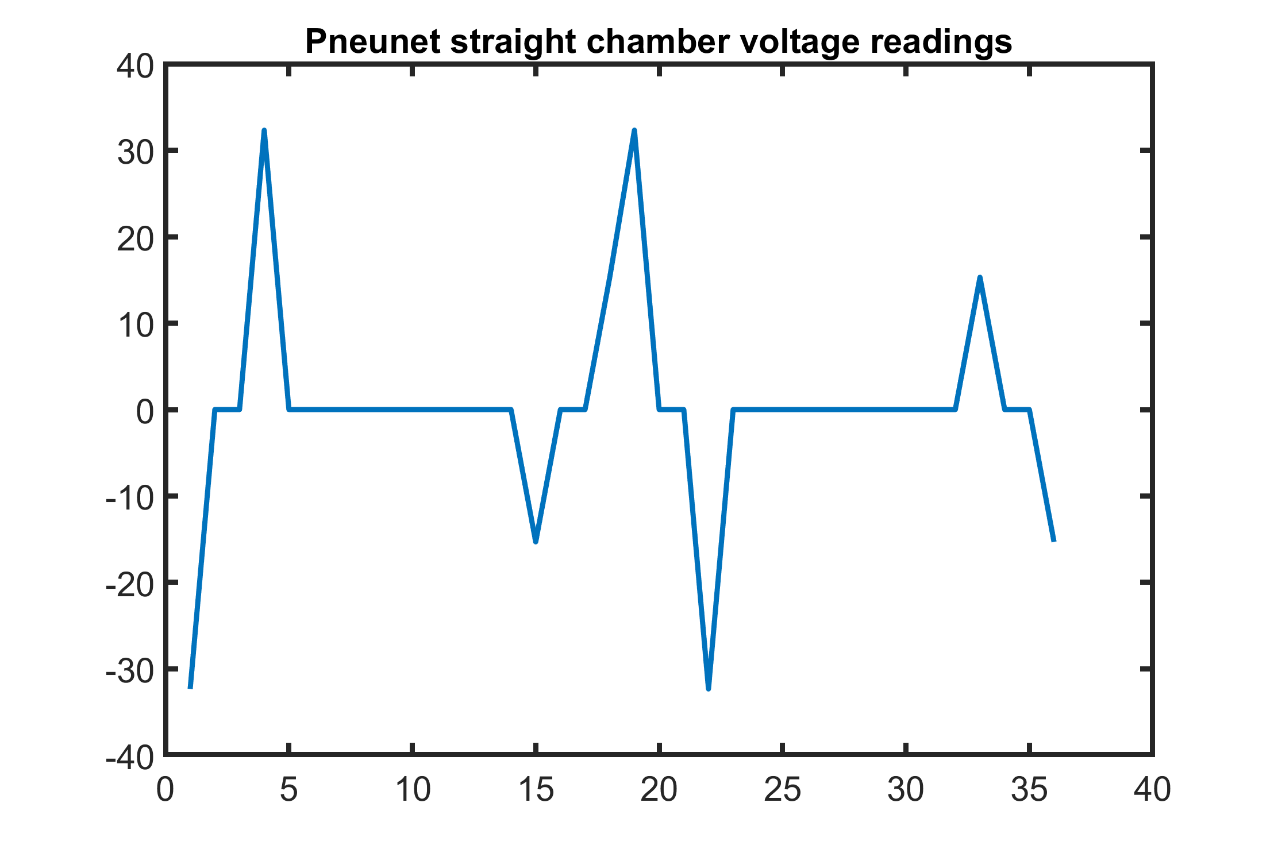
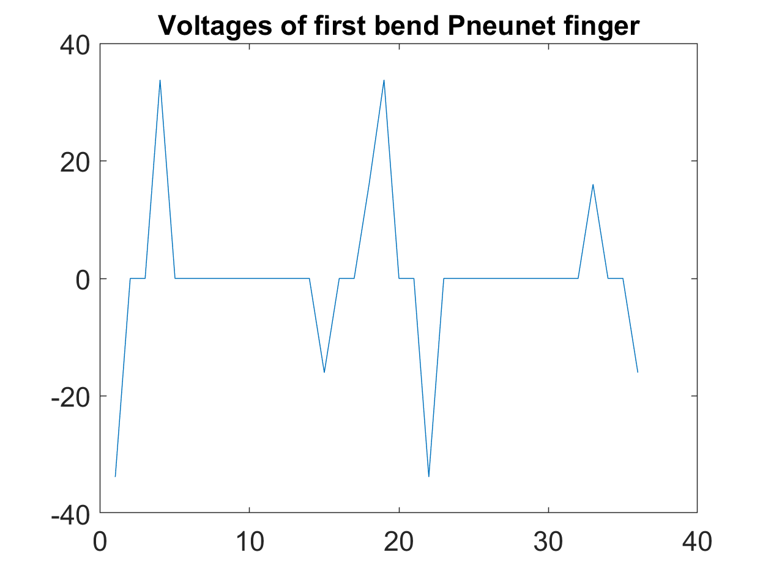
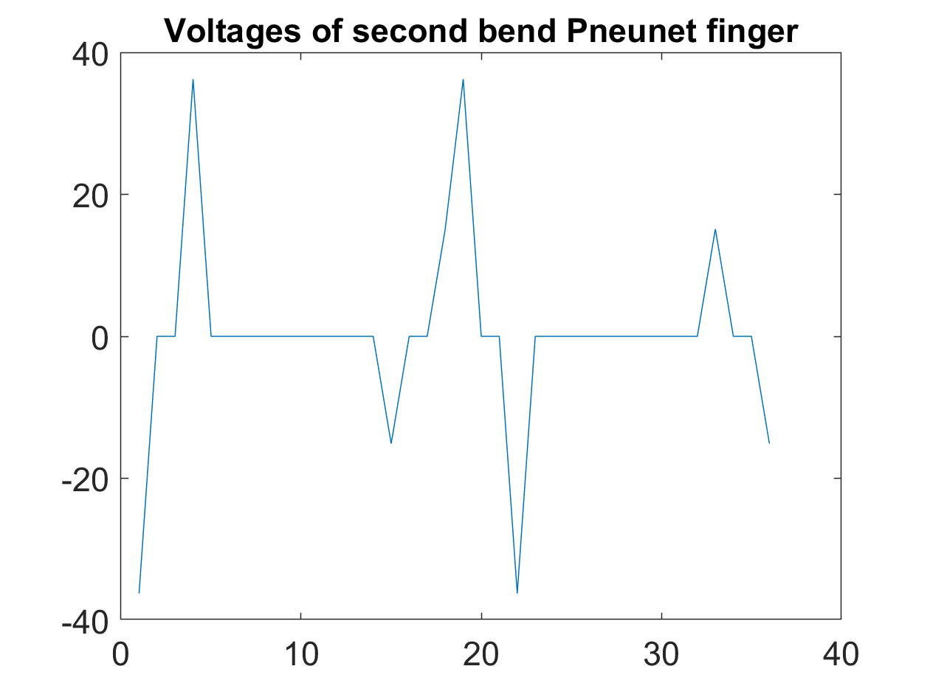
Voltages for each finger configuration:

Slide 5
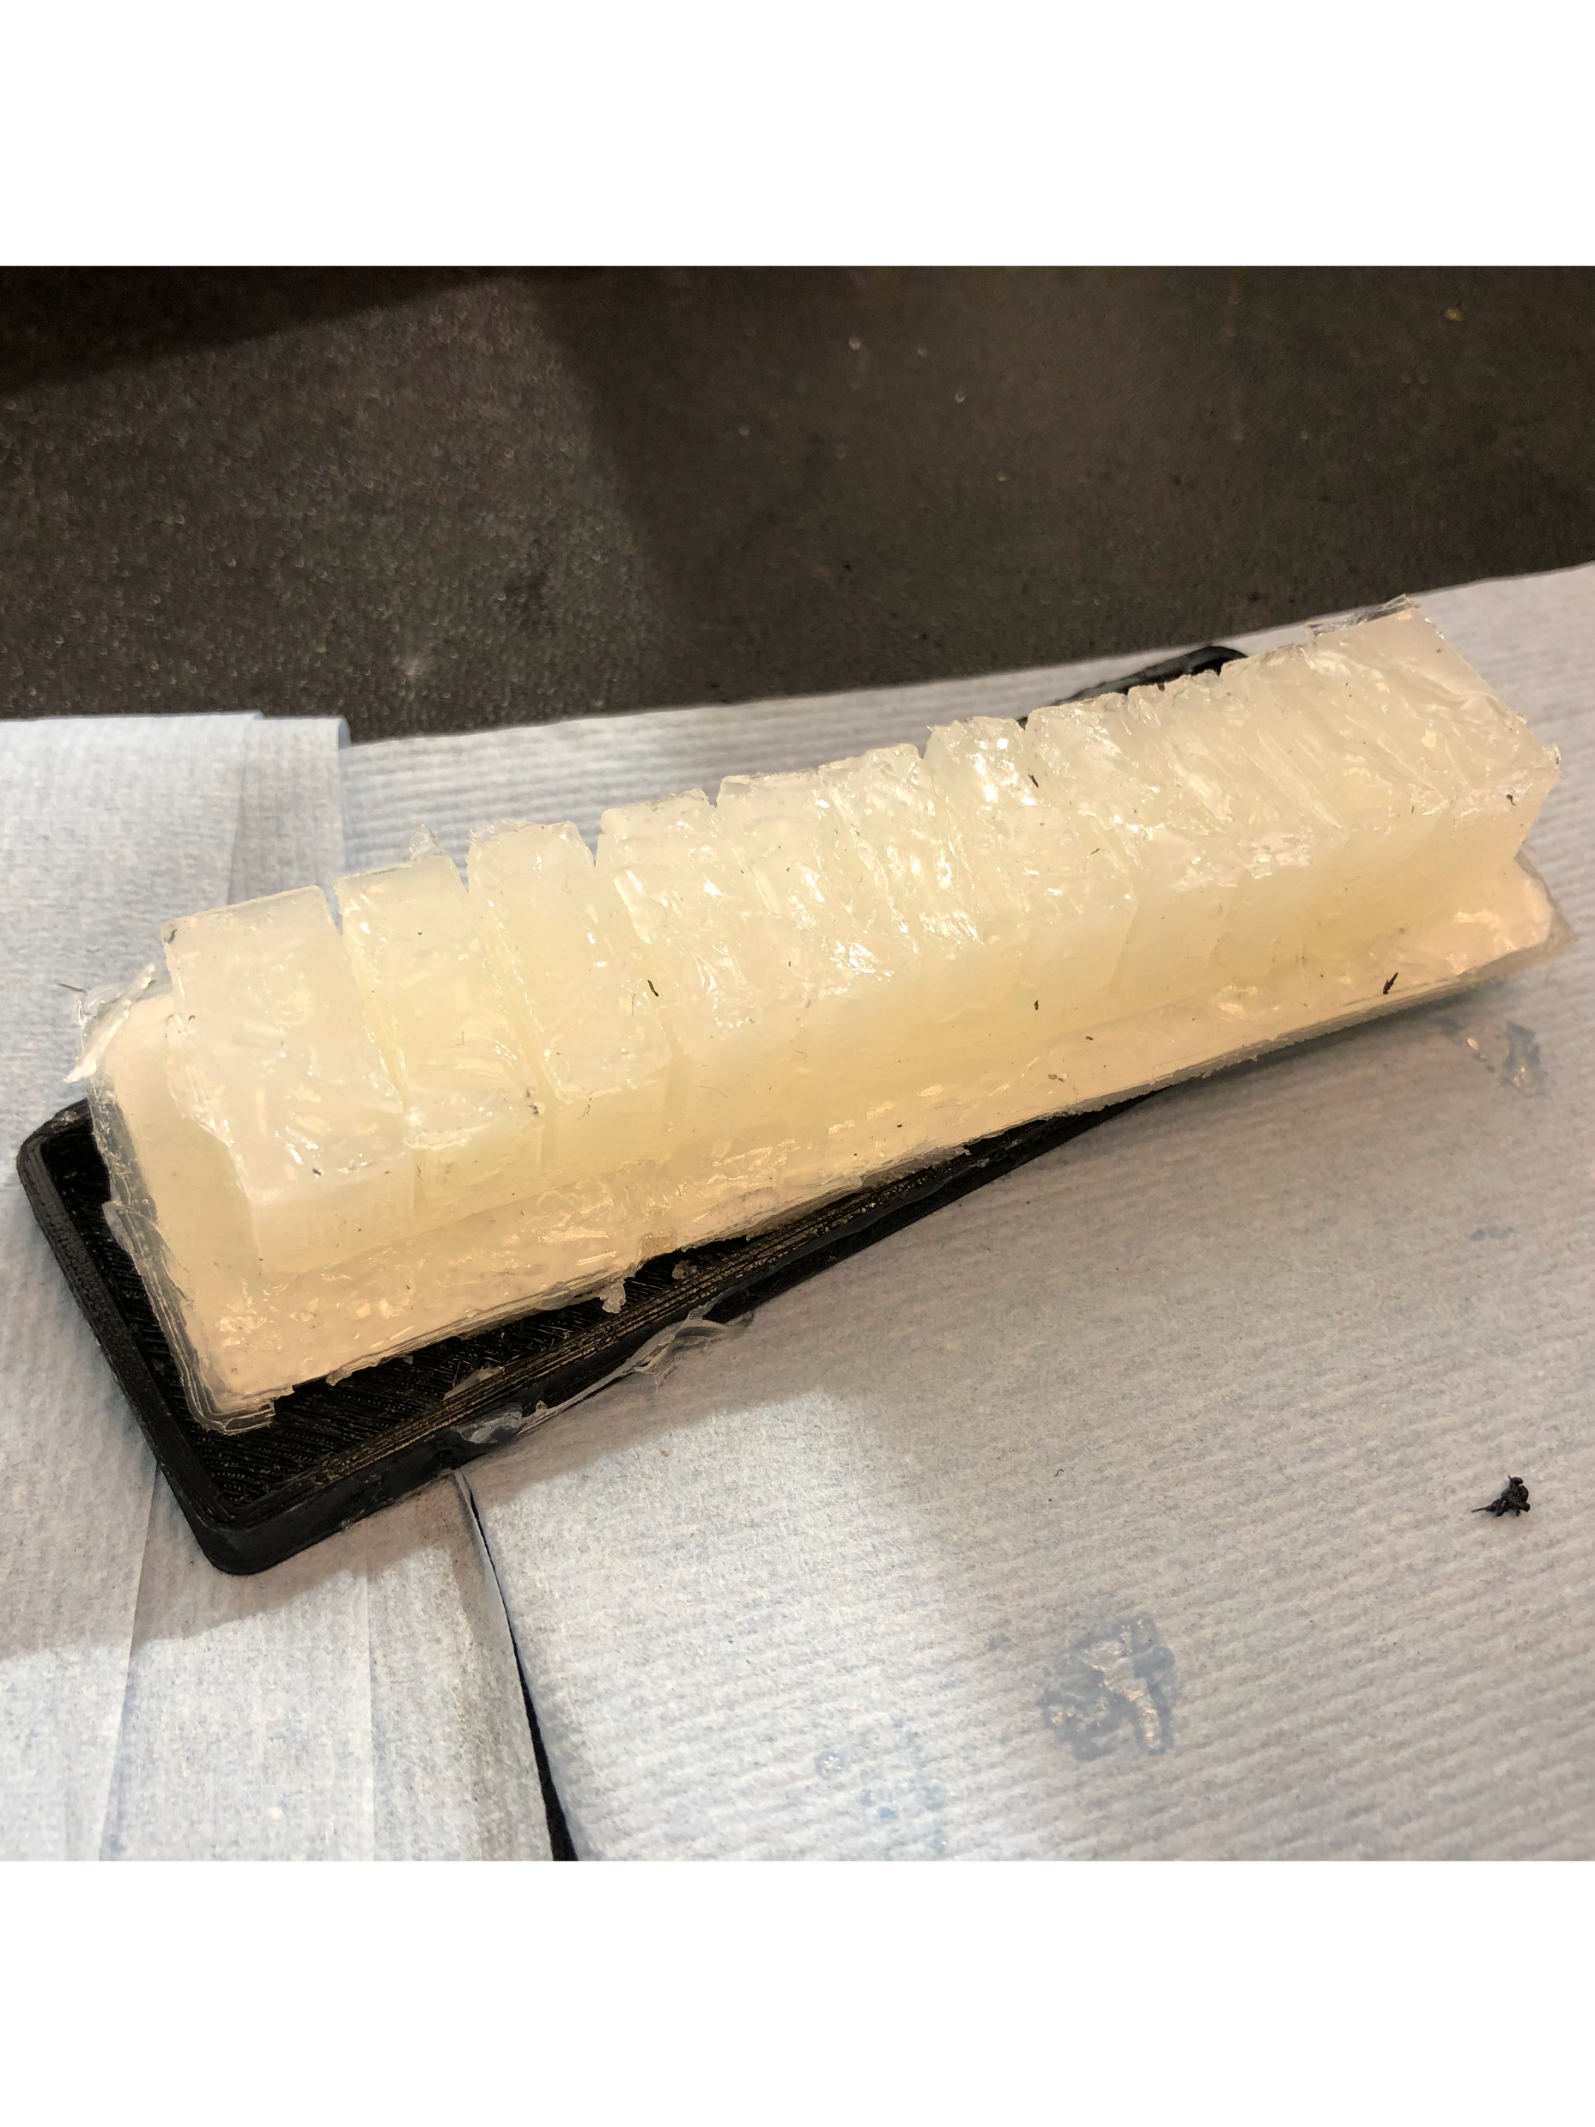
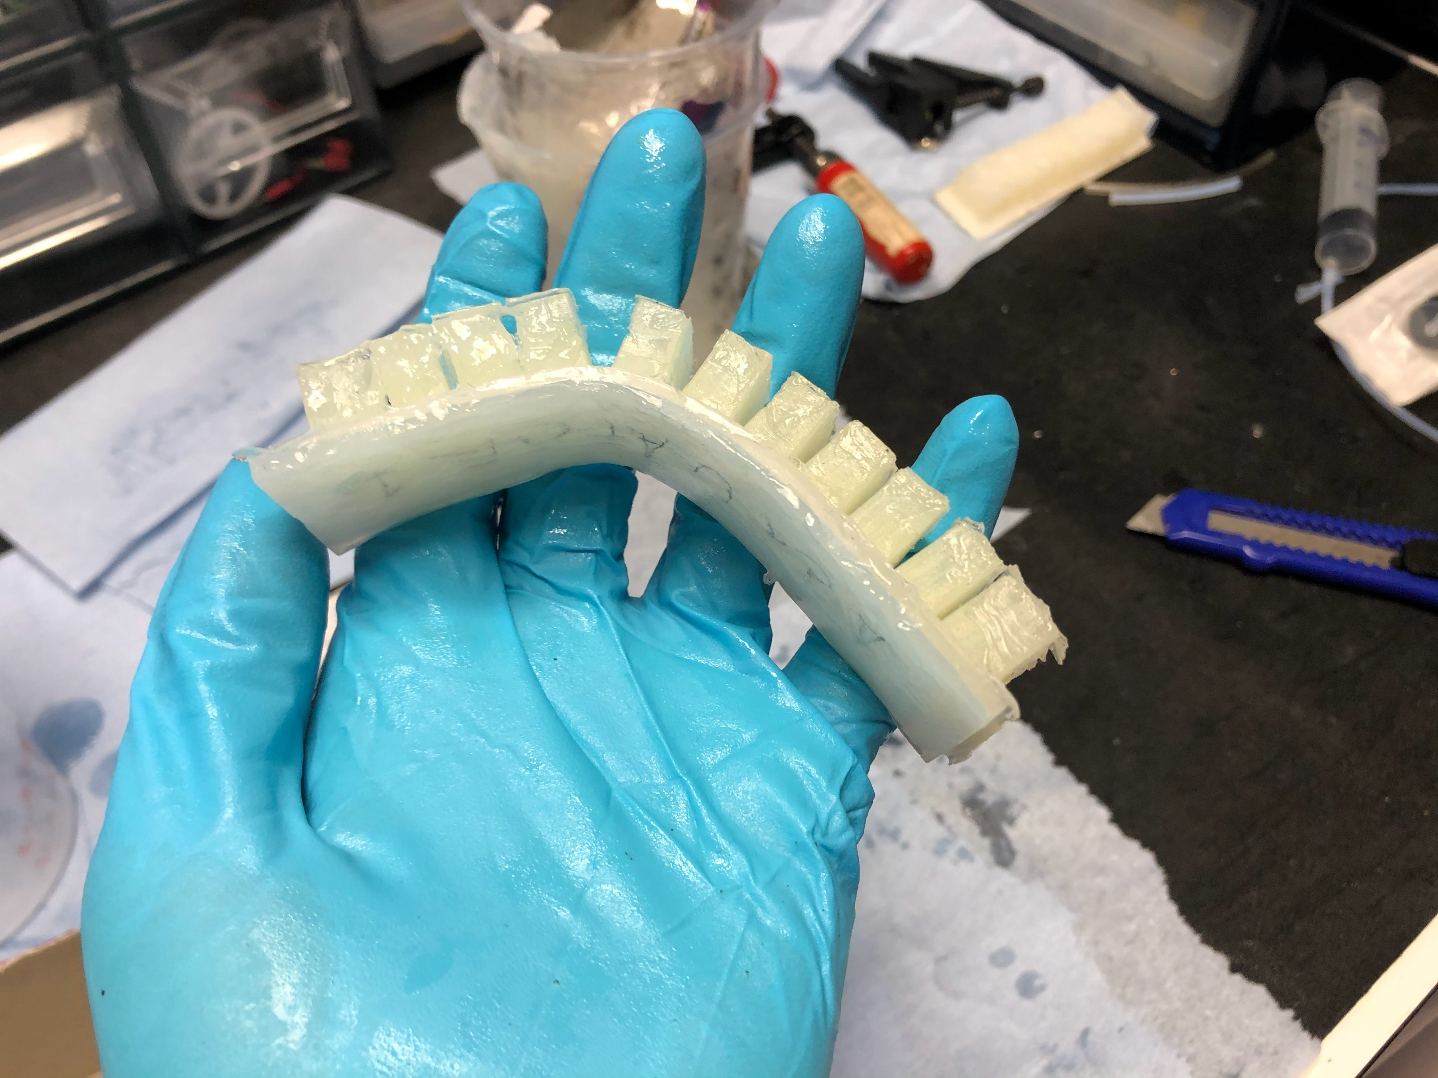
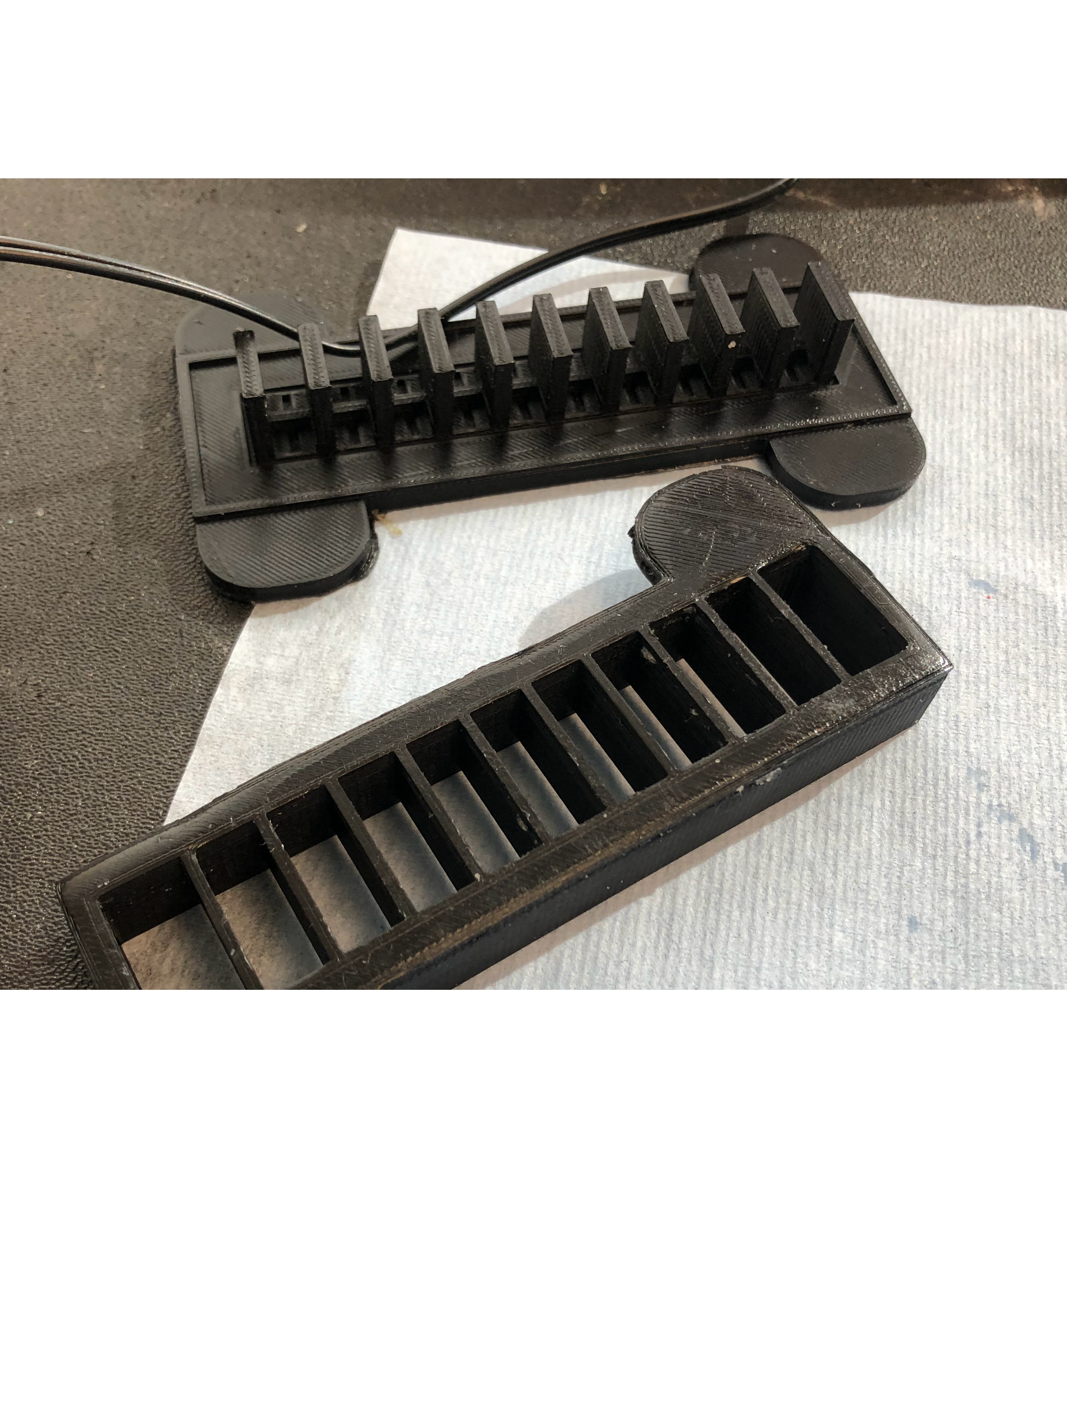
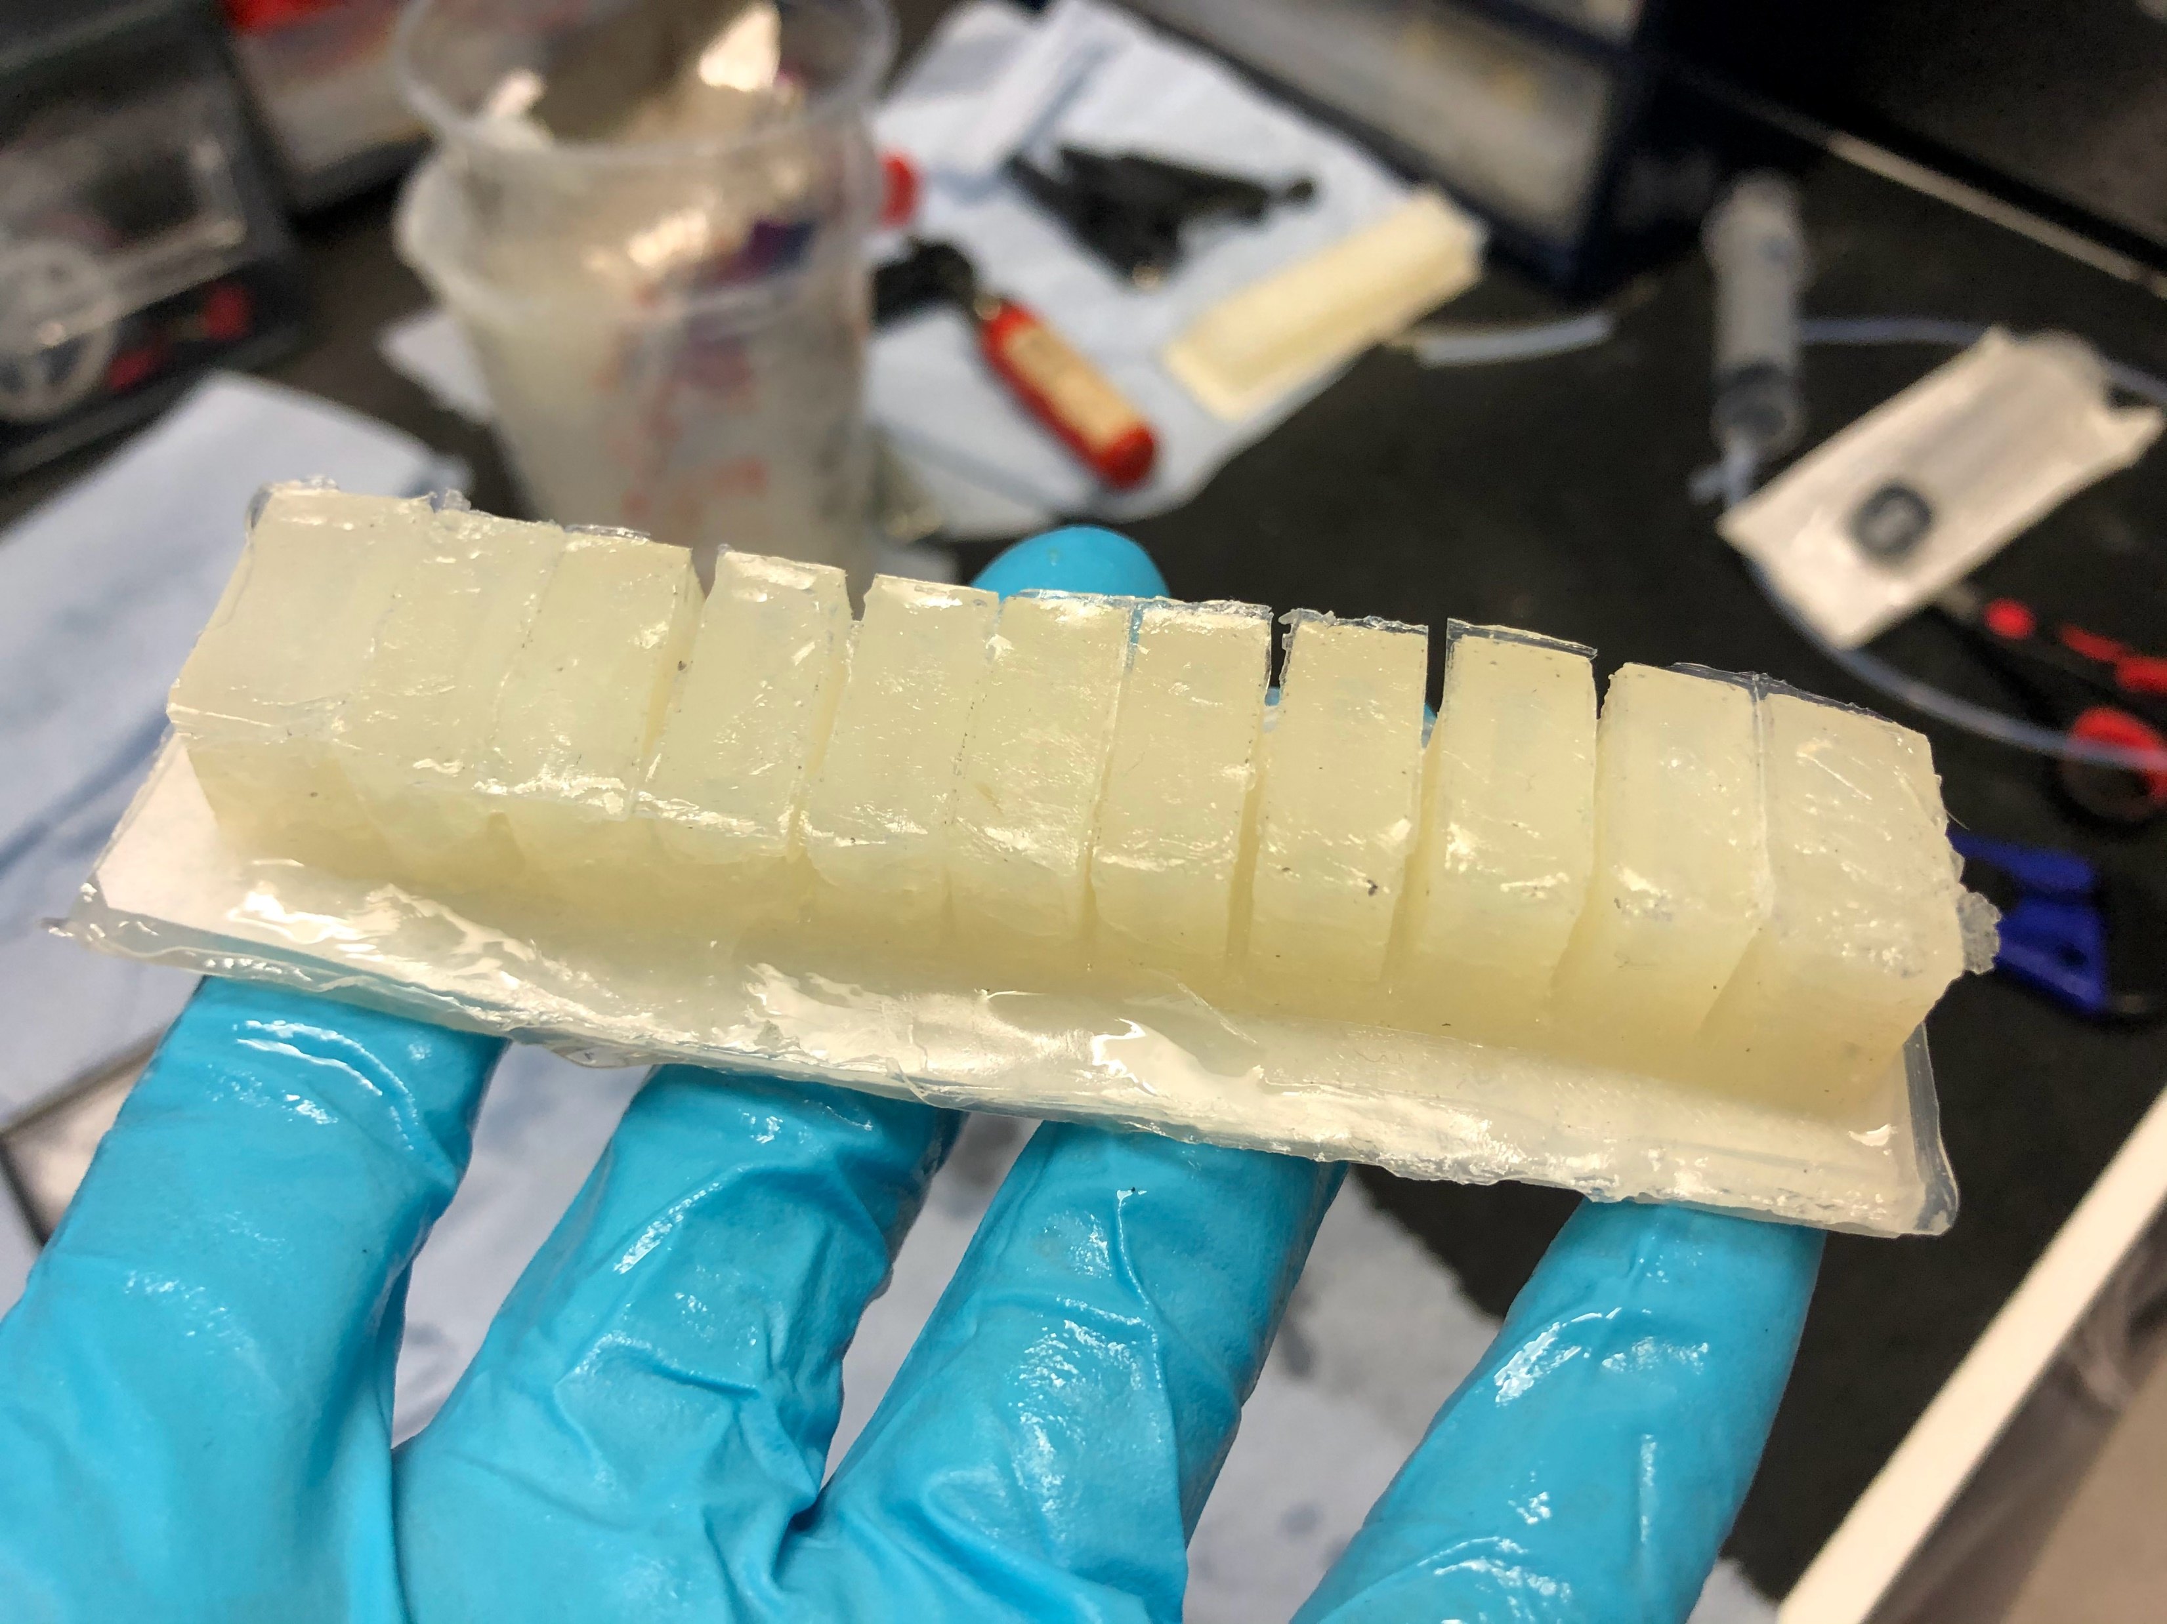

Slide 6
To do for this upcoming week:
Refine EIDORS simulation
Make functioning actuator
Start to integrate electrodes/work with EIT hardware+software
Revise literature review

